Slide 1

The Battle of Neighborhoods
Let’s find good Turkish food
Lets’ find I can open my restaurant (clustering and segmentation)

Slide 2
Introduction
I chose New York City because of two things.
Diversity of population in the City generated different needs and services especially when it comes to food.
Due to this, there are many restaurants in New York City, each belonging to different categories like Turkish, Chinese, Turkish, French, etc.
The main aim of my project is to find, estimate and visualize all major parts of New York City that has good Turkish restaurants.
It can be useful to future owners of the restaurants for finding potentially good area in order to open a new one

Slide 3
Data
Data source: https://cocl.us/new_york_dataset
Description: This data set contains the required information. And we will use this data set to explore various neighborhoods of New York City.
Turkish restaurants in each neighborhood of New York City.
Data source: Foursquare API
Description: By using this API we will get all the venues in each neighborhood. We can filter these venues to get only Turkish restaurants.

Slide 4
Methodology
Collect the New York City data from https://cocl.us/new_york_dataset
Using Foursquare API we will find all venues for each neighborhood.
Filter out all venues that are Turkish restaurants.
Find ratings, tips and like count for each Turkish restaurant using Foursquare API.
Using rating for each restaurant, we will sort that data.
Visualize the Ranking of neighborhoods using folium library(python)
Find clustering where I can open a new restaurant

Slide 5
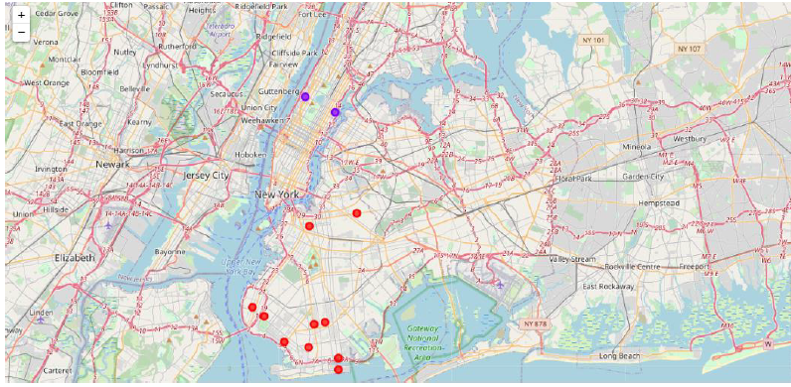
Results and analysis
There are restaurants of Turkish cuisine.in Brooklyn and Manhattan
In Brooklyn there are a many of them
But in Manhattan there is a room for opening ones

Slide 6
Conclusion
For opening a new restaurant someone should analyze competition in the neighborhood. Here is one analysis of potential area in order to open good Turkish restaurant.
First of all, we find average ratings of neighbor’s restaurants and places where are settled in. After clustering of data we can notice where are the places which are the best for starting a new business.
This is the program for data analyzing of location Turkish restaurants and finding places where someone can open a new one.

